Slide 2
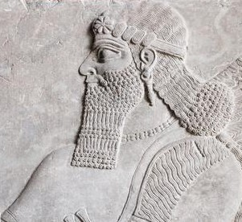
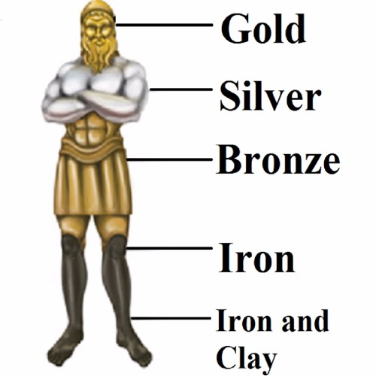
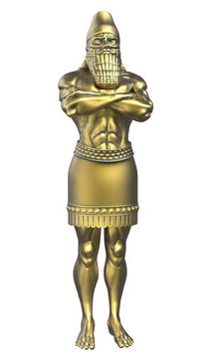
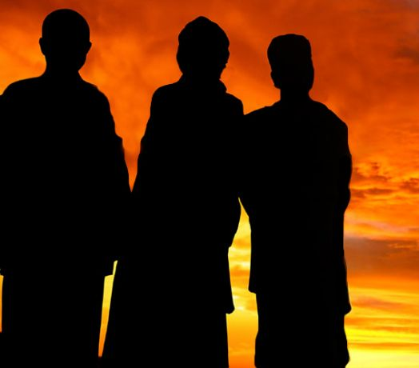
DANIEL

Slide 3
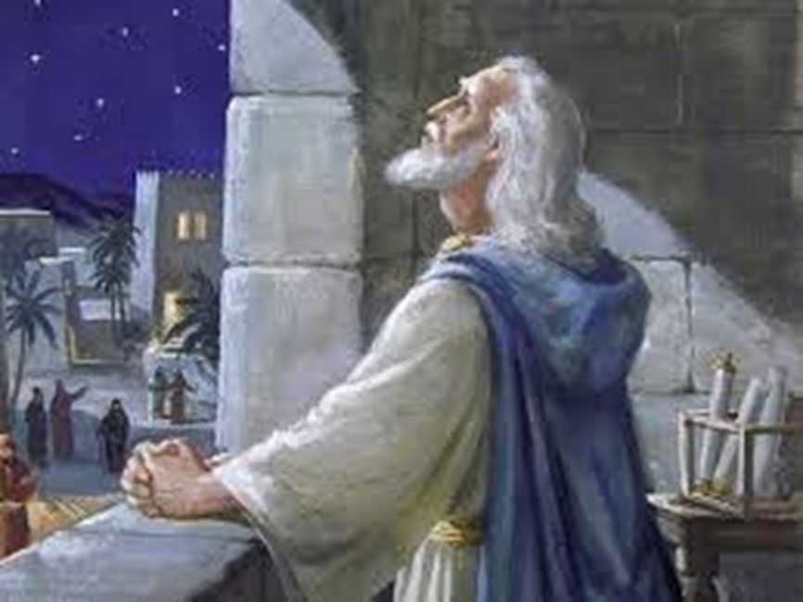
DANIEL 6:1-5
DANIEL IN PRAYER

Slide 4
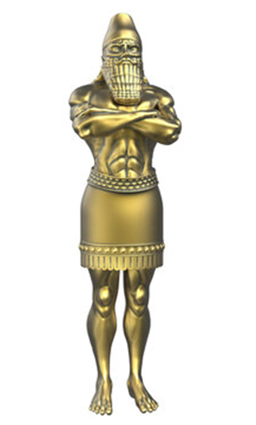
DANIEL’S TRIAL
All good men are tried!
DANIEL 6:6-9
This attacked the foundation of Daniel’s religious conviction!
Once signed, could not be changed

Slide 5
DANIEL’S BEHAVIOR IN TRIAL
Some things he MIGHT have done
The “law of expediency”
"when in Rome, do as the Romans“
"self-preservation!“
"followed the path of least resistance!"

Slide 6

WHAT DID DANIEL DO?
Daniel 6:10
He did what he ALWAYS did!
Usual Place, Usual Times
Daniel 6:12-17
More concerned about what would happen if he Did NOT continue to pray to God!
Daniel did not waver one bit!

Slide 7
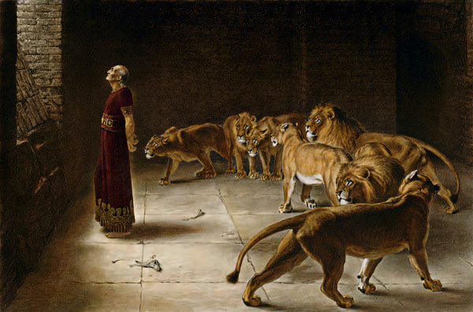
THE DELIVERANCE
“Your God, whom you serve continually, He will deliver you.”
Daniel 6:18-23
Usual Place, Usual Times
Daniel 6:12-17
Acts 12:1-11
Daniel 6:24
Galatians 6:7

Slide 8
Matthew 10:39
May we with Daniel BE
FIRM AND UNCOMPROMISING IN OUR CONVICTIONS
CONTINUALY FAITHFUL TO OUR GOD – NO MATTER WHAT THE IMMEDIATE CONSEQUENCES MAY BE!

Slide 9
MAY WE EVER BE TRUE
TO THE DOCTRINE OF OUR LORD AND SAVIOR, JESUS CHRIST
DANIEL WAS DELIVERED BECAUSE:
Served God Continually
Was Innocent of wrongdoing before the King
Was Innocent of wrongdoing before God

